Slide 1
of the
Specialised Information Service (SIS)
Middle East‐,North Africa‐ and Islamic Studies (Halle / Germany)
Notes:
1

Slide 2
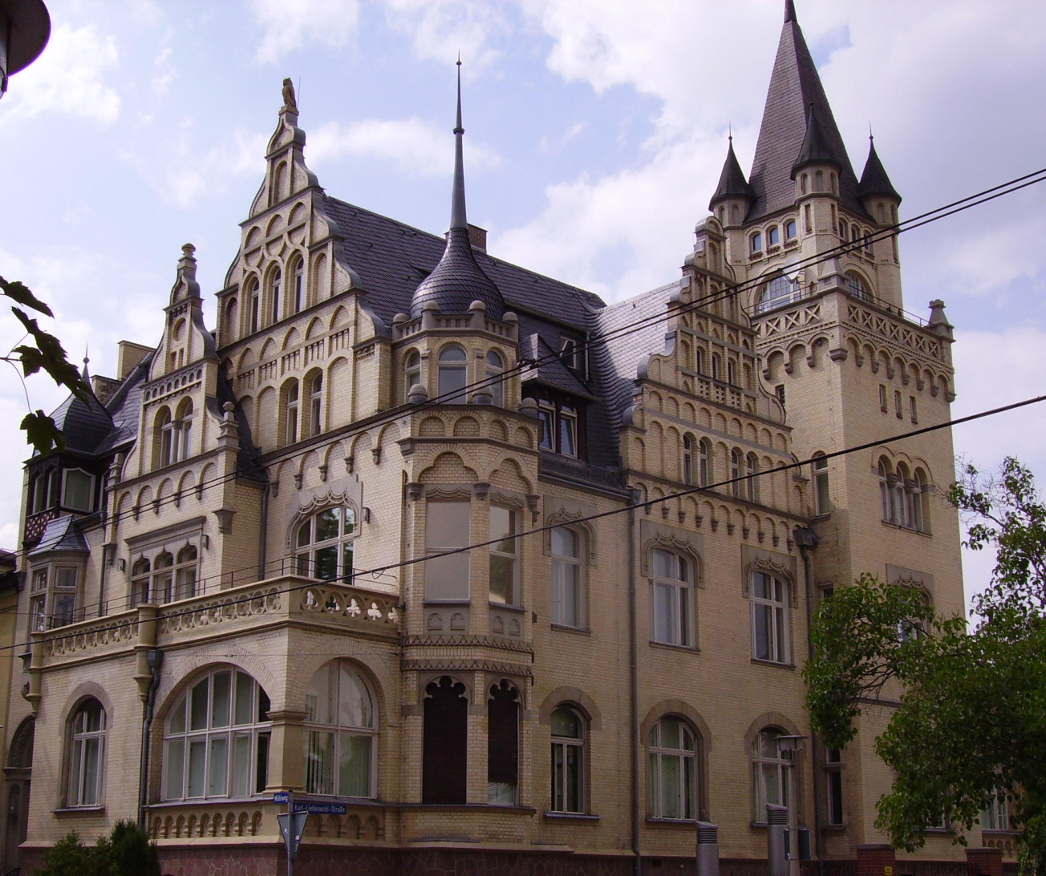
The Specialized Information Service (SIS)
Former Special Subject Collection Middle East / North Africa
Initial period 2016–2018 funded by the DFG
Regional focus on the Middle East, North Africa and Islamic Studies
Subject repository MENAdoc since 2007
MENAdoc: Content and service
The library building in Halle / Germany
Notes:
2

Slide 3
MENAdoc Content
A. Copyright free material: selection according to subject criteria
In languages of the MENA region (old holdings of the DMG, rarities from the Orient-Institut Istanbul)
Secondary literature (Semitic / Islamic Studies)
User requests
Notes:
3

Slide 4
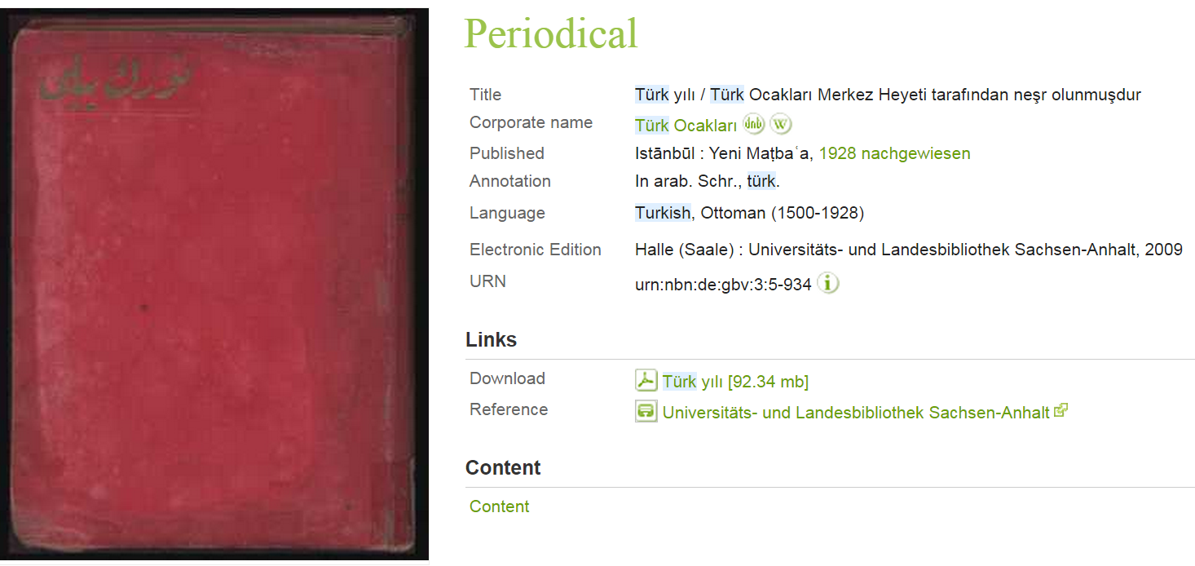
MENAdoc Content
A. Copyright free material: selection according to subject criteria
In languages of the MENA region (old holdings of the DMG, rarities from the Orient-Institut Istanbul)
Secondary literature (Semitic / Islamic Studies)
User requests
Notes:
4

Slide 5
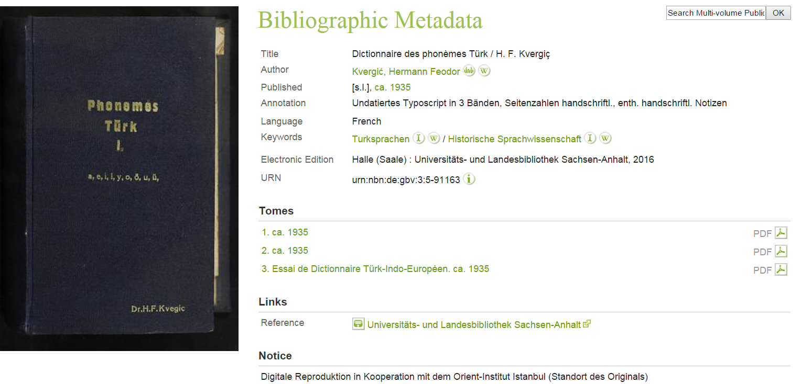
MENAdoc Content
A. Copyright free material: selection according to subject criteria
In languages of the MENA region (old holdings of the DMG, rarities from the Orient-Institut Istanbul)
Secondary literature (Semitic / Islamic Studies)
User requests
Notes:
5

Slide 6
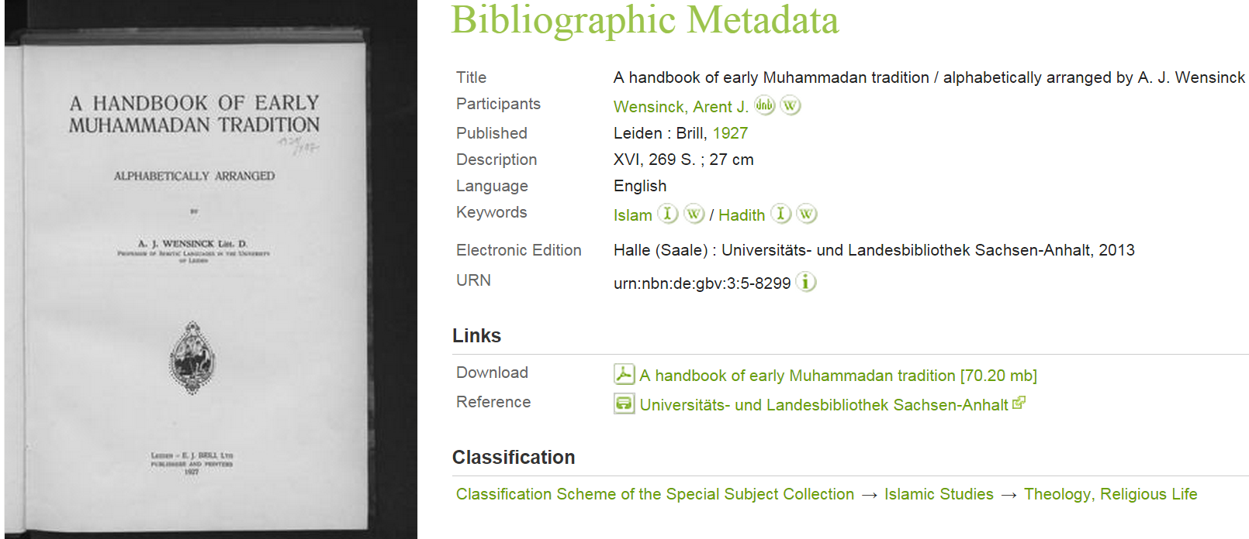
MENAdoc Content
A. Copyright free material: selection according to subject criteria
In languages of the MENA region (old holdings of the DMG, rarities from the Orient-Institut Istanbul)
Secondary literature (Semitic / Islamic Studies)
User requests
Notes:
6

Slide 7
MENAdoc Content
A. Copyright free material: selection according to subject criteria
In languages of the MENA region (old holdings of the DMG, rarities from the Orient-Institut Istanbul)
Secondary literature (Semitic / Islamic Studies)
User requests
Notes:
7

Slide 8
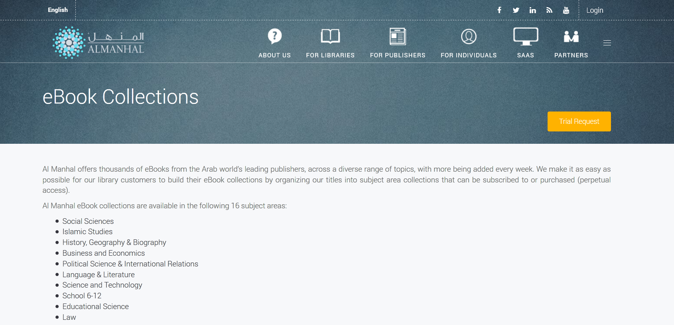
MENAdoc Content
B. Copyright protected material
Primary literature (licenced literature in MENA languages) Al Manhal
Secondary literature
Gold open access
Notes:
8

Slide 9
MENAdoc Content
B. Copyright protected material
Primary literature (licenced literature in MENA languages) Al Manhal
Secondary literature
Gold open access
Notes:
9

Slide 10
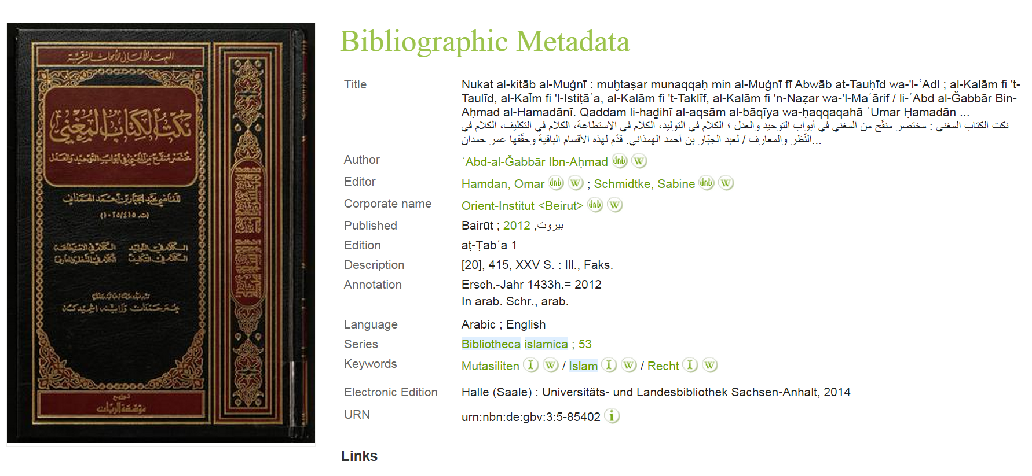
MENAdoc Content
B. Copyright protected material
Primary literature (licenced literature in MENA languages) Al Manhal
Secondary literature
Gold open access
Notes:
10

Slide 11
Beiruter Texte und Studien
MENAdoc Content
Istanbuler Texte und Studien

Slide 12
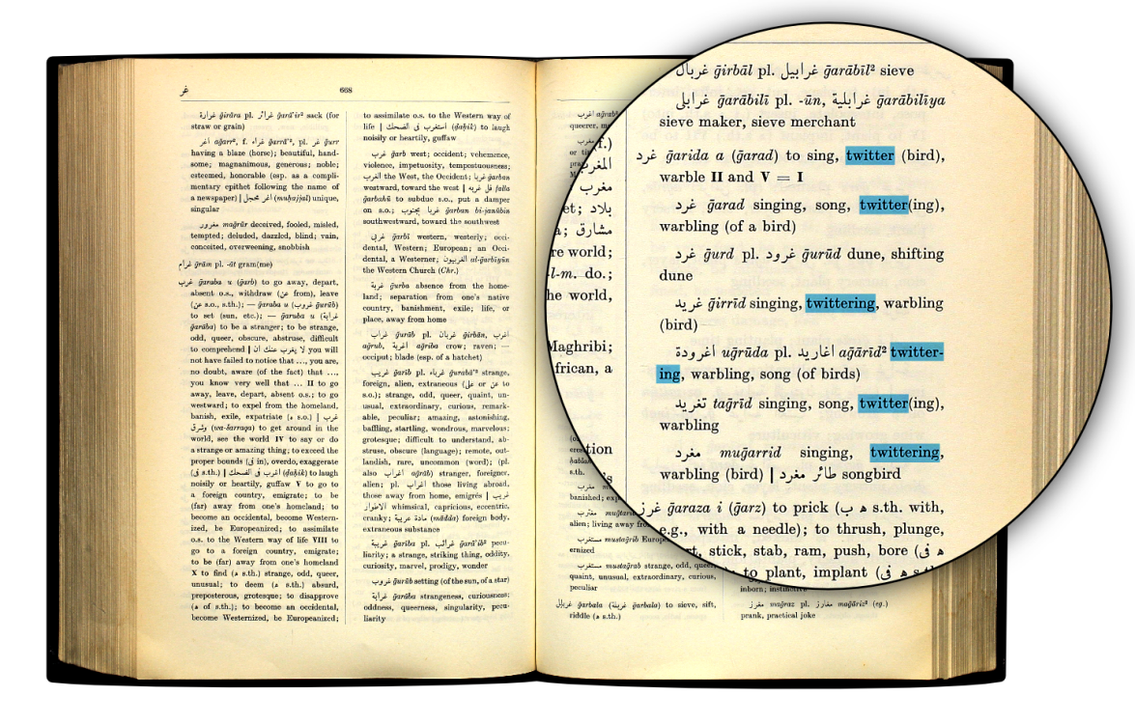
MENAdoc Content
B. Copyright protected material
Primary literature (licenced literature in MENA languages) Al Manhal
Secondary literature
Gold open access
Notes:
12

Slide 13
Out of print works DNB
MENAdoc Service

Slide 14
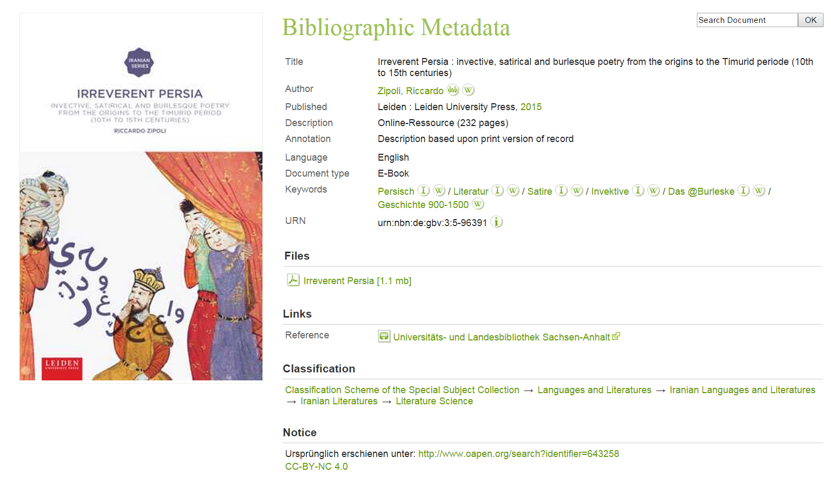
MENAdoc Content
B. Copyright protected material
Primary literature (licenced literature in MENA languages) Al Manhal
Secondary literature
Gold open access
Notes:
14

Slide 15
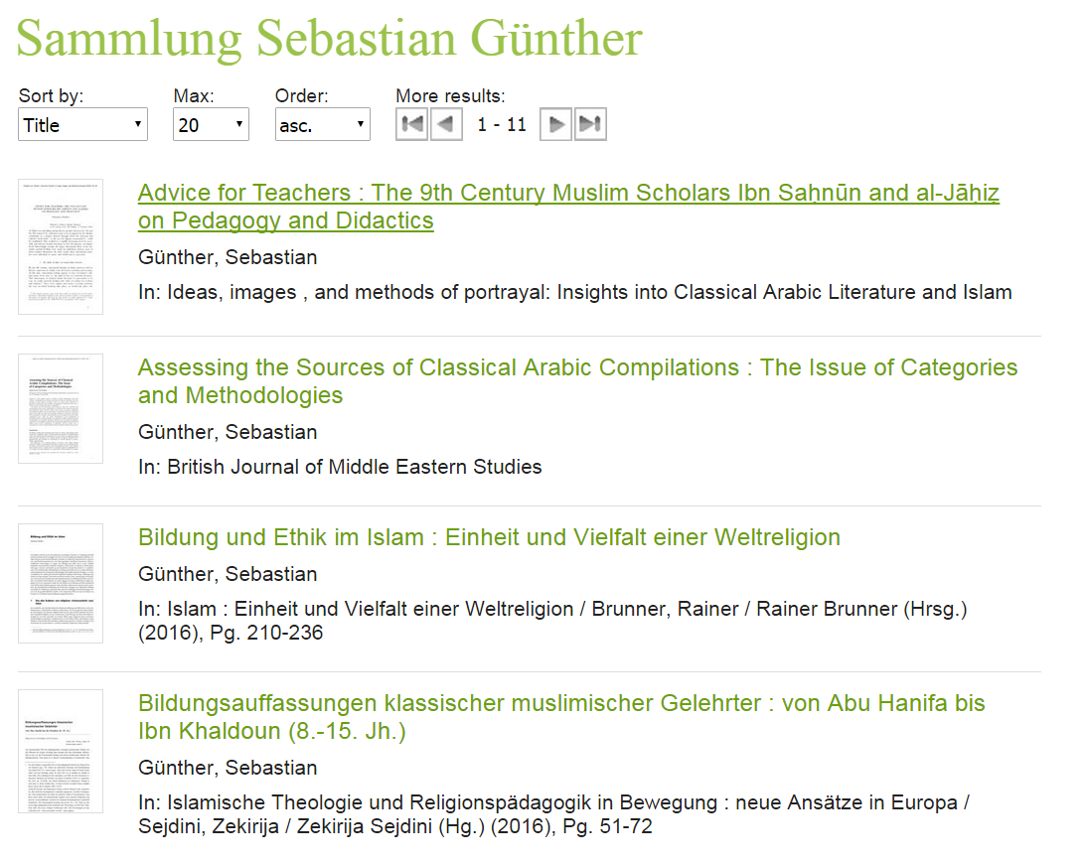
MENAdoc Content
B. Copyright protected material
Primary literature (licenced literature in MENA languages) Al Manhal
Secondary literature
Gold open access
Notes:
15

Slide 16
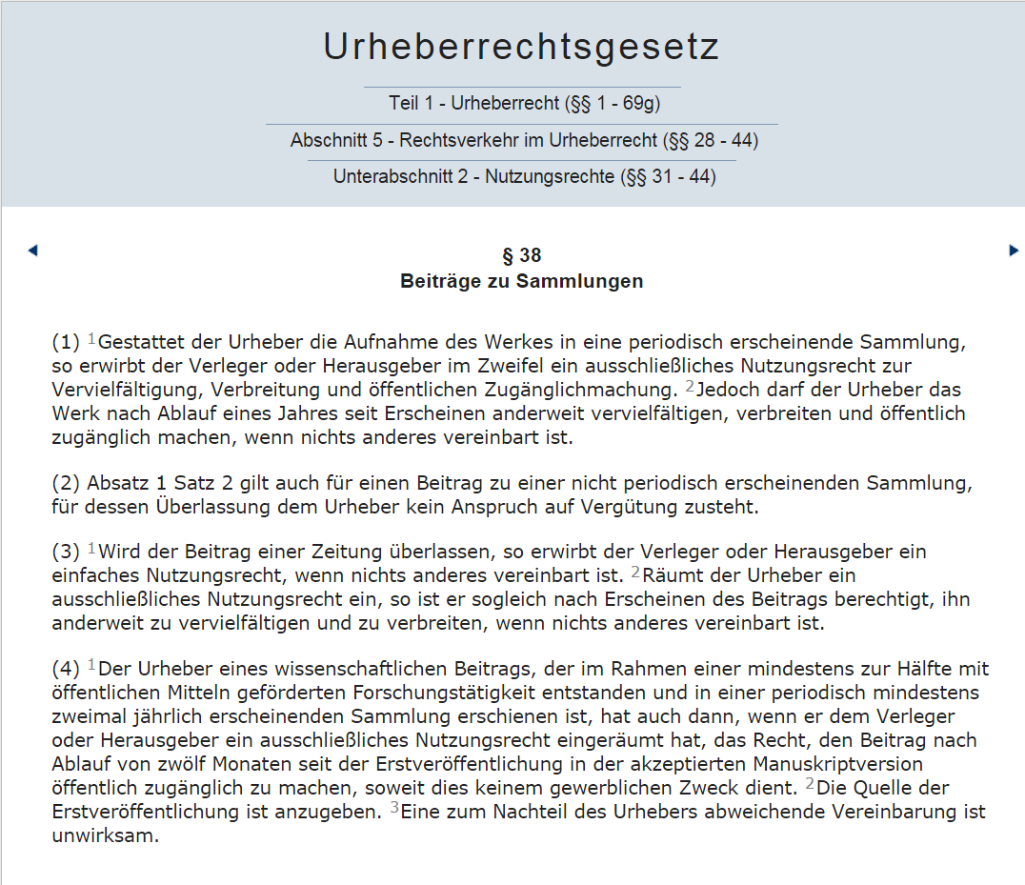
MENAdoc Service
Secondary Publishing Rights
Self Archiving Rights

Slide 17
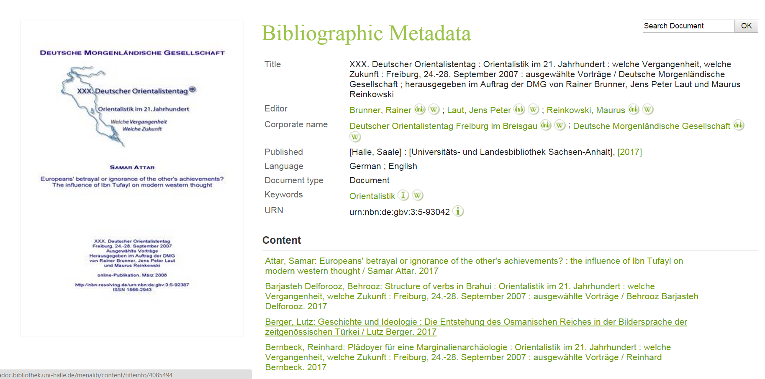
MENAdoc Content
B. Copyright protected material
Primary literature (licenced literature in MENA languages) Al Manhal
Secondary literature
Gold open access
Notes:
17

Slide 18
MENAdoc – The Future
Goals (2019–2021)
Migration to an open source solution (DSpace Community)
Improving text recognition (OCR) for Arabic
Secondary publication Germany-wide - legal advice for green open access
Cataloging and data exchange with catalogs such as WorldCat, Base etc.
Search via Discovery-System Hal:Lit
Public relation (Twitter / Newsletter)

Slide 19
Challenge: Full Text Recognition of Arabic Texts
Published in 1890
Published in 1999
Kraken ibn ocropus
Notes:
19

Slide 20
MENAdoc – The Future
Goals (2019–2021)
Migration to an open source solution (DSpace Community)
Improving text recognition (OCR) for Arabic
Secondary publication Germany-wide - legal advice for green open access
Cataloging and data exchange with catalogs such as WorldCat, Base etc.
Search via Discovery-System Hal:Lit
Public relation (Twitter / Newsletter)

Slide 21
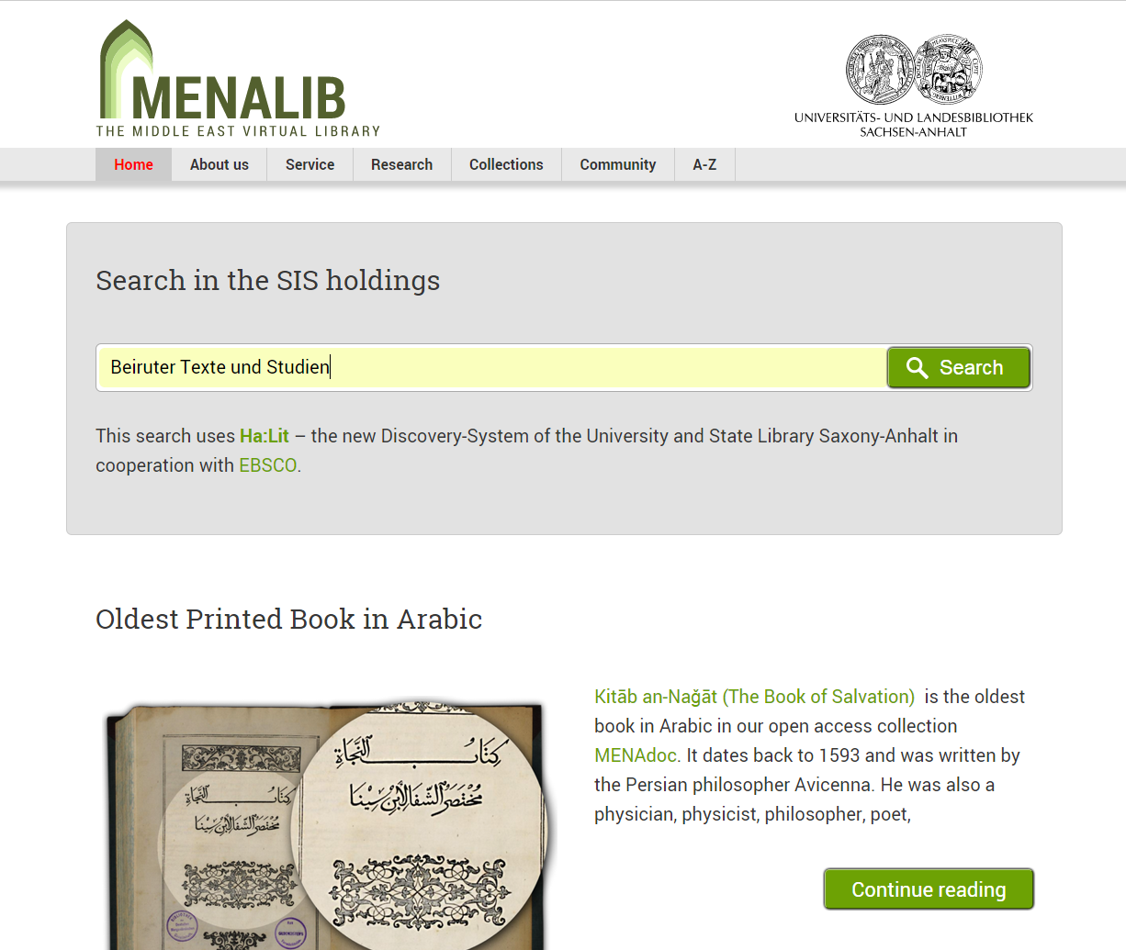
Public Relation – Website
The virtual library MENALIB becomes portal of the SIS with new features
Better research tools
Thematic literature lists
Editorial articles
User-oriented structure
Newsletter
Twitter
www.menalib.de
Notes:
21

Slide 22
Public Relation – Website | Search Tools
Results with the Discovery-Search

Slide 23
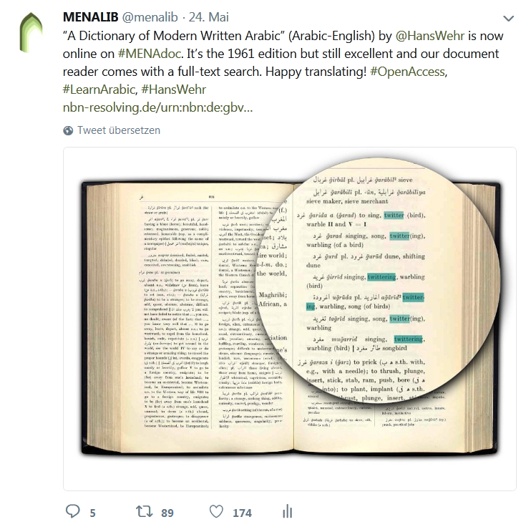
Public Relation – Social Media
Twitter @menalib
Announcements:
Open access titles
Projects
Exhibitions
Events
New releases
Rarities
International target group
www.twitter.com/menalib
Notes:
23

Slide 24
The End
Thanks for your attention and...
AND THE
MENAdoc TEAM
HALLE
Notes:
24

