Slide 1
Shifting from MARC21 to RDA: Challenges of Cataloging Arabic Manuscripts By Muneer Abu Baker
MELCom International 40th Annual Conference
Budapest, Hungary
19-22/06/2018
Library and Information Centre of the Hungarian Academy of Sciences

Slide 2
What is RDA?
Resource Description and Access (RDA)
وصف واتاحة المصادر (وام)
RDA is the successor cataloging standard to AACR2.
The Library of Congress and many other libraries worldwide have now implemented RDA.
Until new protocols are developed, RDA cataloging continues to use both MARC and ISBD in library cataloging.

Slide 3
RDA Challenges
NO RDA Arabic translation
There is no standard Arabic translation yet available for the RDA guidelines, except some personal endeavors.
Mr. Muhammad Muawwad did translate a couple of documents for RDA practices, but his translations are not considered official authorized Arabic translations and they do not cover the entire RDA guidelines.
So, while cataloging Arabic script materials, catalogers still have many of RDA fields in English language.

Slide 4
Some of the fields that reflect the challenge of lacking RDA Arabic translation

Slide 5
1. Publication information and new MARC field : 260- 264
260 is replaced by 264 and provides separate statements for information about publication, distribution, manufacture, and copyright.
2nd indicator describes the function
264 Second indicator:
0 Production
1 Publication
2 Distribution
3 Manufacture
4 Copyright notice date

Slide 6
1. Publication information and new MARC field : 260- 264…cont.
In the publication area, the use of “S.l.” is replaced with “place of publication not identified” and “s.n.” is replaced with “publisher not identified.”
AACR2, when you could not even guess place of publication or name of publisher:
[S. l.] : [s.n.]
[د.م] : [د.ن]
RDA:
[Place of publication not identified] : [publisher not identified]
[مكان النشر غير معرف] : [الناشر غير معرف]

Slide 7
2. Extent of text
In the physical description area, terms such as “pages,” “volumes,” “portraits,” “illustrations,” and “color illustrations” are now spelled out.
Examples:
AACR2
86, [21] p. : col. ill., 1 folded map ; 24 cm.
102، [12] ص. : إيض. لو.، خريطة مطوية ؛ 24 سم.
RDA
86 pages, 21 unnumbered pages : colored illustrations, 1 folded map ; 24 cm
102صفحة، 21 صفحة غير مرقمة : إيضاحيات ملونة، خريطة مطوية ؛ 24 سم
1 volume (Loose-leaf) = 1 مجلد (ورق سائب)
approximately 600 pages = حوالي 600 صفحة
329, that is, 392 pages = 329، أي،392 صفحة
450 pages in various pagings = 450 صفحة في تعدادات مختلفة للصفحات
256 leaves in various foliations = 256 ورقة في تعدادات مختلفة للأوراق

Slide 8
3. No more [General Material Designation]
GMD replaced by three new elements:
Content type = نوع المحتوى
(performed music, spoken word, text, etc.)
337 Media type = نوع الوسائط
(audio, microform, video, etc.)
Carrier type = نوع الناقل
(audio disc, online resource, videodisc, etc.)

Slide 9
3. No more [General Material Designation]…cont.
MARC Code List for Content Types:
RDA Content Terms 336 $a | MARC Codes for RDA Terms 336 $b | RDA Content Terms 336 $a (Arabic)
text | txt | نص
notated music | ntm | موسيقى مرمزة/مدونة
two-dimensional moving image | tdi | صورة متحركة ثنائية الأبعاد
three-dimensional form | tdf | شكل ثلاثي الأبعاد
cartographic image | cri | صورة خرائطية
computer program | cop | برنامج حاسوب

Slide 10
3. No more [General Material Designation]…cont.
MARC Code List for Media Types:
RDA Media Terms 337 $a | MARC Codes for RDA Terms 337 $b | RDA Media Terms 337 $a (Arabic)
audio | s | صوتي، سمعي
computer | c | حاسوب
microform | p | مصغر
unmediated | n | بدون وسيط
video | v | فيديو
projected | g | إسقاطي

Slide 11
3. No more [General Material Designation]…cont.
MARC Code List for Carrier Types:
RDA Carrier Terms 338 $a | MARC Codes for RDA Terms 338 $b | RDA Carrier Terms 338 $a (Arabic)
audio disc | sd | قرص صوتي
online resource | cr | مصدر آلي مباشر
videodisc | vd | قرص فيديو
volume | nc | مجلد
overhead transparency | gt | جهاز عرض رأسي للشفافات
computer disc | cd | قرص حاسوب
Notes:
There are different categories of carrier terms – audio, computer, microform, microscopic, projected image, stereographic, unmediated, video, and unspecified.

Slide 12
3. No more [General Material Designation]…cont.
Print manuscript
AUTHOR 100 1 Ghazzī, Muḥammad ibn Qāsim,|d1454 or 1455-1512 or 1513.
TITLE 240 1 0 Fatḥ al-qarīb al-mujīb
TITLE 245 1 0 Kitāb sharḥ al-ʻālim al-ʻallāmah wa-al-baḥr al-fahhāmah Shams al-Dīn Abī ʻAbd Allāh Muḥammad ibn Qāsim al-Ghazzī al-Shāfiʻī al-musammá Fatḥ al-qarīb al-mujīb ʻalá al-kitāb al-musammá bi-al- Taqrīb aw al-Qawl al-mukhtār fī sharḥ Ghāyat al-ikhtiṣār ʻalá madhhab al-Imām al-Shāfiʻī. Wa-bi- hāmishihi al-matn al-madhkūr /|cli-Abī al-Ṭayyib Shihāb al-Millah wa-al-Dīn Aḥmad ibn al-Ḥusayn ibn Aḥmad al-Iṣfahānī al-shahīr bi-Abī Shujāʻ.
ADD TITLE 246 30 Qawl al-mukhtār
PUB INFO 264 1 Adīs Abābā :|bDār al-ʻUlūm al-Muḥammadīyah,|c1331 [1913]
DESCRIPT 300 92 pages ;|c25 cm
DESCRIPT 336 text|btxt|2rdacontent
DESCRIPT 337 unmediated|bn|2rdamedia
DESCRIPT 338 volume|bnc|2rdacarrier
DESCRIPT 300 92 صفحة ;|c25 سم
DESCRIPT 336 نص|btxt|2rdacontent
DESCRIPT 337 بدون وسيط|bn|2rdamedia
DESCRIPT 338 مجلد|bnc|2rdacarrier
Online manuscript
AUTHOR 100 1 Ghazzī, Muḥammad ibn Qāsim,|d1454 or 1455-1512 or 1513,|eauthor.
TITLE 245 1 0 Fatḥ al-Qarīb al-Mujīb /|cMuḥammad ibn Qāsim Ghazzī.
ADD TITLE 246 3 Hādhā sharḥ matn Abī Shujāʻ al-musammá bi-Fatḥ al-Qarīb al- Mujīb fi-sharḥ alfāẓ al-taqrīb
PUB INFO 264 1 [al-Qāhirah] :|b[publisher not identified],|c[1864]
DESCRIPT 300 1 online resource (197 images)
DESCRIPT 336 text|btxt|2rdacontent
DESCRIPT 337 computer|bc|2rdamedia
DESCRIPT 338 online resource|bcr|2rdacarrier
PUB INFO 264 1 [القاهرة] :|b[الناشر غير معرف],|c[1864]
DESCRIPT 300 1 مصدر آلي مباشر(197 صورة)
DESCRIPT 336 نص|btxt|2rdacontent
DESCRIPT 337 حاسوب|bc|2rdamedia
DESCRIPT 338 مصدر آلي مباشر|bcr|2rdacarrier

Slide 13
4. Relator terms
Name access points are followed by terms describing the role of the person or organization:
e.g., author, editor, composer, filmmaker, performer, production company, sponsoring body
No equivalents in Arabic for the new relator terms in RDA such as the words used for occupation in the Authority records.
For instance, in English the editor role will be written as “editor”, while in Arabic there is no standard translation for “editor”, so the terms Muhaqiq (محقق) and Muharir (محرر) are both used by catalogers.
Notes:
Designation of function that describes the relationship between a name and a work,

Slide 14
Arabic Language Relators
4. Relator terms…cont.
Some Relator designation codes in 100 $e and 700 $e are the following:
RDA Terms 100, 700 $e | MARC Codes for RDA Terms 100, 700 $e | RDA Terms 100, 700 $e (Arabic)
Abridger | abr | ملخص. موجز. مختصر
Annotator | ann | شارح. معلق الحواشي
Commentator | cmm | معقب. معلق. مفسر
Corrector | crr | محقق
Redactor | red | منقح. محرر
Restorationist | rsr | مرمم. أخصائي ترميم
Reviewer | Rev | مراجع. معقب. ناقد. معلق

Slide 15
Arabic terms for Relators
4. Relator terms…cont.
What about words like:
corrector or rectifier = مهذب (من تهذيب النص)
corrector or averter = مستدرك (من استدراك على النص)
commentator or annotator = مذيل (من التذيل على النص)
Mr. Muhammad Muawwad has a translated Arabic list for MARC Relators code and terms
http:// www.slideshare.net/Muawwad/ss-25871703

Slide 16
4. Relator terms…cont.
Appendix I designators
130 0 Quran.|kSelections.
245 1 3 al-Mushaf al-sharif :|b(nuskhat Tubinghin) /|cdirasat wa-taòhqiq al-Duktur Tayyar Alti Qulach.
246 1 5 al-Mushaf al-sharif =|bMushaf-̧ ðserãif : (Tèubingen nèushaş)
246 1 1 Mushaf-̧ ðserãif : (Tèubingen nèushaş)
264 1 Istanbul :|bIRCICA, Markaz al-Abhath lil-Tarikh wa-al-Funun wa-al-Thaqafah al-Islamiyah bi-Istanbul,|c2016.
300 54, 309, 50 pages :|bcolor illustrations, color facsimiles ;|c28 cm
336 text|btxt|2rdacontent
336 still image|bsti|2rdacontent
337 unmediated|bn|2rdamedia
338 volume|bnc|2rdacarrier
490 0 Silsilat nusus muhaqqaqah ;|v10
490 0 çIncelemeli metin serisi ;|v10
500 Includes facsimile reproduction of manuscript.
504 Includes bibliographical references.
546 Text in Arabic; with introductory matter and contents in Arabic and Turkish.
630 0 0 Quran|xManuscripts|vFacsimiles.
630 0 0 Quran|xCriticism, Textual.
650 0 Manuscripts, Arabic|zGermany|zTèubingen|vFacsimiles.
700 1 |6880-05|aAltķulac, Tayyar,|d1938-|eeditor,|ewriter of supplementary textual content.
710 2 |6880-06|aResearch Centre for Islamic History, Art, and Culture,|eissuing body.
710 2 Universitèat Tèubingen.|bUniversitèatsbibliothek.|kManuscript.|nMa VI 165.

Slide 17
RDA Challenges…cont.
RDA presents more complexities to the catalogers
giving more burden to deal with new terminologies and the idea of understanding new concepts associated with RDA.
Access point (not added entry)
Authorized access point (Not main entry or headings)
Variant access points (not see references)
Authorized access point for related entity (not see also references)
Preferred title for a work (not uniform title)
Creator (not author)
Preferred access point (not heading)
Carrier description (not physical description)
Preferred sources (not chief source)
Not to mention the new terms of Work, Expression, Manifestation and Item (WEMI) and the relationships between them.

Slide 18
RDA Challenges…cont.
RDA is based mainly on the conceptual models for bibliographic and authority data
Functional Requirements for Bibliographic Records (FRBR) and Functional Requirements for Authority Data (FRAD) that was first published by the International Federation of Library Association (IFLA), yet it is different when it comes to implementation and that what makes RDA really difficult to understand due to its relation to these models. By reviewing many OPACS of libraries in the Arab Region, the relation between RDA and FRBR still not existing.
RDA is expensive to be implemented and require very detailed and extensive training.

Slide 19
RDA Challenges…cont.
RDA did not achieve its objectives and principles to be comprehensive, clear, adaptable, and easy to use.
Most bibliographic and authority records created by RDA rules take longer time than their AACR2-based counterparts.
In RDA, the rule of three no longer applies to the naming of works. Resulted in increasing numbers of access points, especially in those records involving more than three names with different roles in the statement of responsibility that require access points such as authors, investigators, reviewers…etc.

Slide 20
Authority Data With RDA
RDA Challenges…cont.
Authority data represents the controlled access points and other information that institutions use to collocate works by a specific person, family, or corporate body, or the various editions of a title.
Changes to MARC Format : New Authority Fields for RDA elements
MARC Tag | MARC label | MARC label (Arabic)
040 $e | Cataloging Source | مصدر الفهرسة
046 | Special Coded Dates | تواريخ مرمزة أخرى
336 | Content Type (Title or Name/title) | نوع المحتوى
368 | Other Attributes of Person or Corporate Body | خصائص الشخص أو الهيئة الأخرى
370 | Associated Place | المكان المصاحب
371 | Address | العناوين البريدية
372 | Field of Activity | مجال النشاط
373 | Associated Group | التبعية

Slide 21
Authority Data With RDA…cont.
RDA Challenges…cont.
Continue -- New Authority Fields for RDA elements
MARC Tag | MARC label | MARC label (Arabic)
374 | Occupation | الوظيفة
375 | Gender | نوع الجنس
376 | Family Information | معلومات الأسرة
377 | Associated Language | اللغة المصاحبة
378 | Fuller Form of Personal Name | الشكل الكامل للاسم الشخصي
380 | Form of work | شكل العمل
381 | Other Distinguishing Characteristics of Work or Expression | خصائص تمييز أخرى للعمل أو التعبير
382 | Medium of Performance | وسيط الأداء
383 | Numeric Designation of a Musical Work | تسمية عددية لعمل موسيقي

Slide 22
RDA Challenges…cont.
Authority Data With RDA…cont.
Creating Authority records is very time consuming (So many details)
Lack of information about authors in Arabic publications to fill the newly added fields such as:
Preferred name
Date of birth / date of death / period of activity
Title of the person
Fuller form of name
Other designation
Profession or occupation
Family information
For every bibliographic record created, associate authority records should be created based on the number of access points in the bibliographic record.

Slide 23
Bibliographic record
LEADER 00000cam 2200529Ii 4500
008 920826s2001 jo h b 001 0 ara d
020 9789957001544
040 ZAQ|bara|cZAQ|erda
043 ma-----
050 4 BL1695|b.I256 2001
100 1 |6880-01|aIbn Maʻn, Ḥusayn ibn Fakhr al-Dīn,|d-1697 or 1698.
240 10 |6880-02|aTamyīz
245 10 |6880-03|aKitāb al-Tamyīz /|cḤusayn ibn Fakhr al-Dīn ibn Qarqamās al- Maʻnī al-maʻrūf bi-Ibn Maʻn ; dirāsat wa- taḥqīq Muḥammad ʻAdnān al-Bakhīt, Nūfān al-Ḥammūd al- Sawārīyah.
250 |6880-04|aal-Ṭabʻah 1 al-ʻArabīyah.
260 |6880-05|aʻAmmān, al-Urdun :|bDār al-Shurūq :|bMuʼassasat al-Turāth al-Durzī,|c2001.
300 |6880-06|a556 pages :|bfacsimiles ;|c24 cm
336 text|btxt|2rdacontent
337 unmediated|bn|2rdamedia
338 volume |bnc|2rdacarrier
504 Includes bibliographical references (pages 517-544) and indexes.
650 0 Druzes|xDoctrines|vEarly works to 1800.
700 1 |6880-07|aBakhīt, Muḥammad ʻAdnān.
700 1 |6880-08|aḤammūd, Nūfān Rajā.
710 2 |6880-09|aDruze Heritage Foundation.
880 1 |6100-01/(3/r|aابن معن, حسين بن فخر الدين,,|dت. 1697 او 8.
880 |6250-04/(3/r|aالطبعة 1 العربية.
880 |6260-05/(3/r|aعمان, الاردن ،|bدار الشروق ،|bمؤسسة التراث الدرزي,|c2001.
880 |6300-06/(3/r|a556 ص. ،|bمثيليات ؛|c24 سم.
880 1 |6700-07/(3/r|aبخيت, محمد عدنان.
880 1 |6700-08/(3/r|aحمود, نوفان رجا.
880 2 |6710-09/(3/r|aمؤسسة التراث الدرزي.
880 10 |6240-02/(3/r|aتمييز
880 10 |6245-03/(3/r|aكتاب التمييز /|c حسين بن فخر الدين بن قرقماس المعني المعروف بابن معن ؛ دراسة وتحقيق محمد عدنان البخيت, نوفان الحمود السوارية.

Slide 24
Associate Authority record
HEADING: | Ibn Maʻn, Ḥusayn ibn Fakhr al-Dīn, -1697 or 1698
000 | 01565cz a2200265n 450
001 | 5620451
005 | 20130319121301.0
008 | 020405n| azannaabn |b aaa c
010 | __ |a nr2002013301
035 | __ |a (OCoLC)oca05731986
040 | __ |a CtY-N |b eng |e rda |c CtY-N |d OCoLC |d DLC
046 | __ |g [1697,1698] |2 edtf
100 | 1_ |a Ibn Maʻn, Ḥusayn ibn Fakhr al-Dīn, |d -1697 or 1698
370 | __ |a Istanbul, Turkey |b Istanbul, Turkey
375 | __ |a male
377 | __ |a ara
400 | 0_ |a Ḥusayn ibn Fakhr al-Dīn ibn Maʻn, |d -1697 or 1698
400 | 1_ |a Ibn Maʻan, Ḥusayn ibn Fakhr al-Dīn, |d -1697 or 1698
400 | 1_ |a Ibn Maʻin, Ḥusayn ibn Fakhr al-Dīn, |d -1697 or 1698
400 | 1_ |a Ibn Maʻn al-Shaʼmī, Ḥusayn ibn Fakhr al-Dīn, |d -1697 or 1698
400 | 1_ |w nnea |a Ibn Maʻn, Ḥusayn ibn Fakhr al-Dīn, |d d. 1697 or 8
400 | 1_ |a ابن معن، حسين بن فخر الدين، |d -1697 or 1698
667 | __ |a Machine-derived non-Latin script reference project.
667 | __ |a Non-Latin script reference not evaluated.
670 | __ |a Kitāb al-Tamyīz, 2001: |b t.p. (Ḥusayn ibn Fakhr al-Dīn ibn Qurqmās al-Maʻnī al-maʻrūf bi-Ibn Maʻin [part. voc.], 1034/1624-1109/1697)
670 | __ |a Ziriklī |b (Ibn Maʻn; Ḥusayn ibn Fakhr al-Dīn ibn Qurqmās al-Maʻnī, wa-yuʻrafu bi-Ibn Maʻn; Druze, b. and d. at Istanbul, Turkey; 1036/1627-1109/1697)
670 | __ |a Brockelmann |b (b. Maʻn aš-Šaʼmī, Ḥu. b. Faḫraddīn Qorqmās b. Maʻn aš-Šaʼmī; d. 1109/1697)
670 | __ |a Kaḥḥālah |b (Ḥusayn ibn Maʻn; Ḥusayn ibn Fakhr al-Dīn ibn Qurqmās, al-Qusṭanṭīnī, al-maʻrūf bi-Ibn Maʻn; d. 1109/1697)

Slide 25
RDA Challenges…cont.
Relationship Designators
The different relationships categories in RDA are mainly found in RDA appendixes I, J, K, L and M.
These lists are the main source for the controlled vocabularies used in cataloging with RDA.
As for Arabic script materials, uncontrolled vocabularies are used as a common practice. Currently there is no Arabic controlled vocabulary list.

Slide 26
RDA Challenges…cont.
Relationship Designators …cont.
Relationships between works and other works and/or expressions in Arabic script materials are totally different from materials in other languages such as English. It is not only different but broader as well.
Mr. Kamal Arafat Nabhan did a noticeable study in 1993 entitled “al-Ilaqaat Bayna al-Nusus fi al-Talif al-Arabi: Dirasah ala Tafaru al-Nusus al-Arabiyah: Manhaj Jadid Li-Ilm al-bibliugrafiah al- takwiniyah” in Arabic language (العلاقات بين النصوص في التأليف العربي : دراسة على تفارع النصوص العربية : منهج جديد لعلم الببليوجرافيا التكوينية) in which he introduced relationships in Arabic script materials.
Nabhan defined more than 60 types of relationships mainly in Arabic rare books and manuscripts.
He also republished his study in 2007 under a different title “Abqariyat al-talif al-Arabi: alaaqat al-nusus wa-al-ittisal al-ilmi” in Arabic language "عبقرية التأليف العربي: علاقات النصوص والاتصال العلمي".

Slide 27
RDA Challenges…cont.
Relationship Designators …cont.
Title | Author | Type of Relationship | Date
Islah Al Mantiq إصلاح المنطق | Ibn al-Sikkit ابن السكيت | Original Text النص الأصلي | 1956
Mukhtasar Islah Al Mantiq مختصر إصلاح المنطق | Al-Wazīr Abī al-Qasīm al-Husayn ibn ʻAlī al-Maghribi الوزير أبي القاسم الحسين ابن علي المغربي | Abridged Work مختصر (Appendix J : Derivative work relationship) abridged as (work) | 1968
Sharh Abyat Islah Al Mantiq شرح أبيات إصلاح المنطق | Yūsuf ibn al-Ḥasan ibn ʻAbd Allāh ibn al-Marzubān يوسف ابن الحسن ابن عبد الله ابن المرزبان | Commentary Work شرح (Appendix J : Descriptive work relationship) commentary on (work) | 1978
Kitab Tahdhib Islah Al Mantiq كتاب تهذيب إصلاح المنطق | Yaḥyá ibn ʻAlī al-Khaṭīb al-Tibrīzī يحيى ابن علي الخطيب التبريزي | Abridged Work مختصر (Appendix J : Derivative work relationship) abridged as (work) | 1907
Tartīb iṣlāḥ al-manṭiq ترتيب إصلاح المنطق | Muḥammad Ḥasan Bakkāʼī محمد حسن بكائي | Analysis Work تحليل (Appendix J : Descriptive work relationship) analysis of (work) | 1991

Slide 28
RDA Challenges…cont.
Relationship Designators …cont.
Appendix J and resource-to-resource relationships
100 1# $a Wazīr al-Maghribi, al-Husayn ibn ʻAlī,$d981-1027, $e author
245 10 $a al-Munakhal :$b Mukhtasar Islah Al Mantiq / $c lil-Wazir Abi al-Qasim al-Husayn ibn Ali al-Maghribi ; haqqaqhu wa-’allaqa ‘alayh wa-sana’a faharisahu Jamal Tulbah.
500 ## $a Mukhtasar Islah Al Mantiq li Ibn al-Sikkit.
700 1# $i Abridgement of (work): $a Ibn al-Sikkit,$d-857 or 858. $t Islah Al Mantiq.
700 1# $a Tulbah, Jamal, $e muhaqiq.
Appendix J and resource-to-resource relationships
Reciprocal relationship
100 1# $a Ibn al-Sikkit,$d-857 or 858, $e author.
245 10 $a Islah Al Mantiq / $c Ibn al-Sikkit.
700 1# $i Abridged as (work): $a Wazīr al-Maghribi, al-Husayn ibn ʻAlī,$d981-1027. $tMunakhal :$b Mukhtasar Islah Al Mantiq.

Slide 29
RDA Challenges…cont.
Relationship Designators …cont.
Appendix J and resource-to-resource relationships
100 1# $a Sirafi, Yusuf ibn al-Hasan,|d 941-995, $e author
245 10 $a Sharh abyat Islah al-mantiq /|c talif Abi Muhammad Yusuf ibn al-Hasan ibn Abd Allah ibn al-Marzuban al-Sirafi al-Nahwi ; tahqiq Yasin Muhammad al-Sawwas.
500 ## $a Sharh abyat Islah al-mantiq li Ibn al-Sikkit.
700 1# $i commentary on (work): $a Ibn al-Sikkit,$d-857 or 858. $t Islah Al Mantiq.
700 1# $a Sawwas, Yasin Muhammad, $e muhaqiq.
Appendix J and resource-to-resource relationships
Reciprocal relationship
100 1# $a Ibn al-Sikkit,$d-857 or 858, $e author.
245 10 $a Islah Al Mantiq / $c Ibn al-Sikkit.
700 1# $i commentary in (work): $a Sirafi, Yusuf ibn al-Hasan,|d 941-995. $ Sharh abyat Islah al-mantiq.

Slide 30
RDA Challenges…cont.
Relationship Designators …cont.
Appendix J and resource-to-resource relationships
100 1# $a Bakkai, Muhammad Hasan, $e author
245 10 $a Tartib islah al-mantiq / $c li-Ibn al-Sikkit ; rattabahu wa-qaddamah lahu wa-allaqa alayh Muhammad Hasan Bakkai.
500 ## $a Tartib islah al-mantiq li Ibn al-Sikkit.
700 1# $i Analysis of (work): $a Ibn al-Sikkit,$d-857 or 858. $t Islah Al Mantiq.
Appendix J and resource-to-resource relationships
Reciprocal relationship
100 1# $a Ibn al-Sikkit,$d-857 or 858, $e author.
245 10 $a Islah Al Mantiq / $c Ibn al-Sikkit.
700 1# $i Analysed in (work): $a Bakkai, Muhammad Hasan. $t Tartib islah al-mantiq.

Slide 31
Examples from OCLC

Slide 32
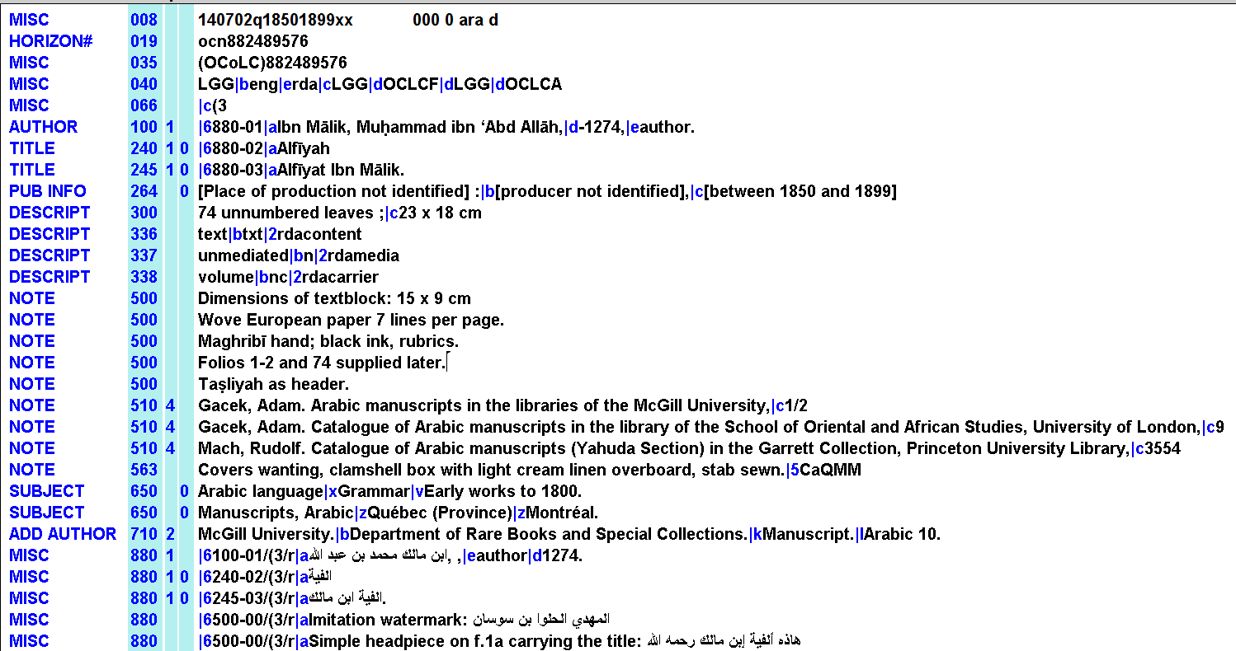
Example1: RDA Display
510 Citation/Reference Note
1st indicator 4 for location in source given
563 Binding Information

Slide 33
Example1: OPAC Display

Slide 34
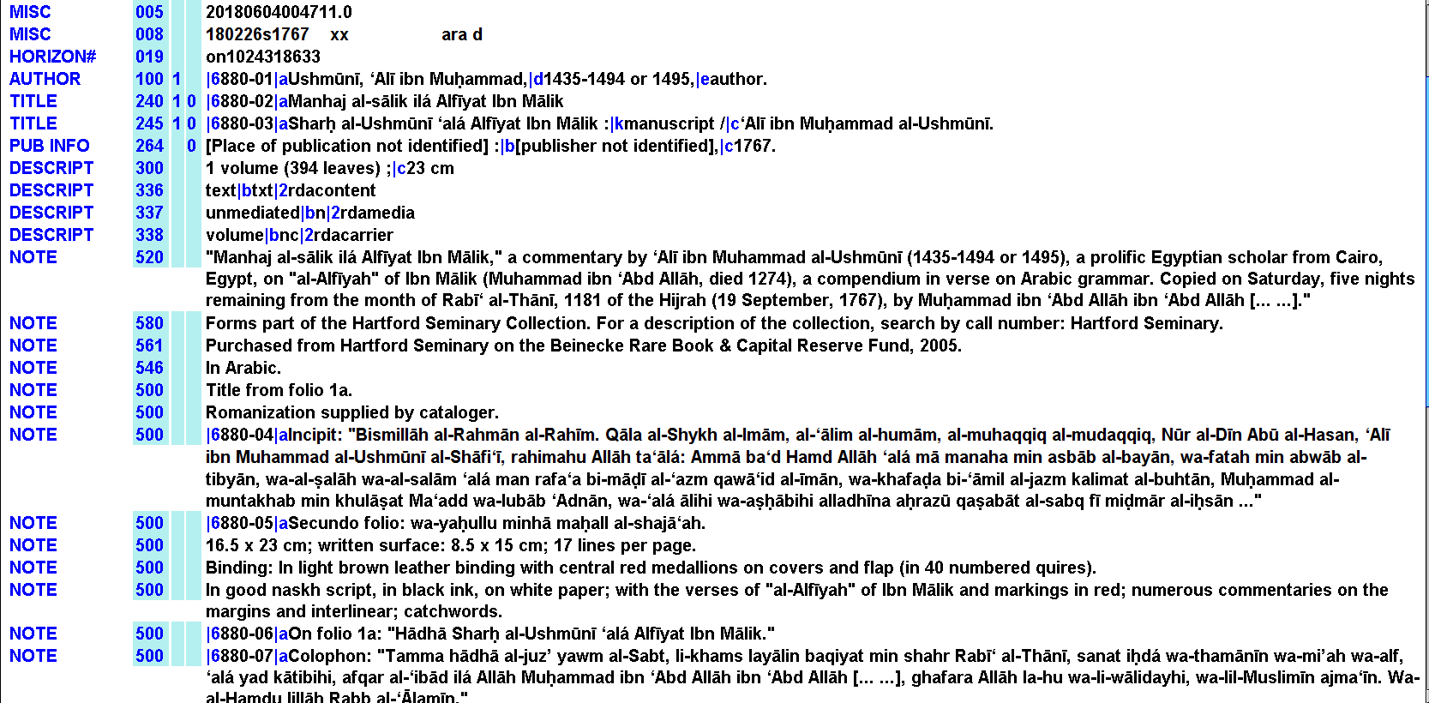
Example 2: RDA Display
1
520 Summary Note
580 Linking Entry Note
546 Language Note
561 Ownership and Custodial History Note
Incipit, colophon, folios, condition of the copy…etc. goes to the general note field 500

Slide 35
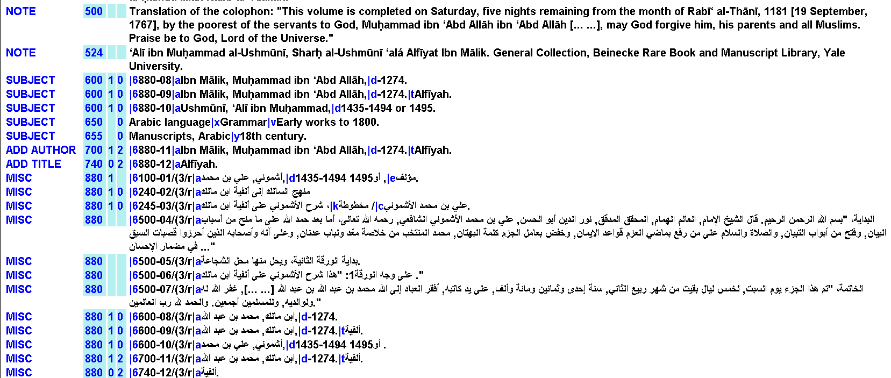
Example 2: RDA Display
2
524 Preferred Citation of Described Materials Note
Incipit: أول النسخة، فاتحة النسخة، بداية النسخة، صدر النسخة
colophon: حرد المتن، قيد الختام

Slide 36
Example 2: OPAC Display
1

Slide 37
Example 2: OPAC Display
2

Slide 38
Conclusion
Although RDA is designed for describing all types of resources; to be more flexible in an international setting; to make it easier for library data to interact with other bibliographic data and designed for the web environment, still it is not fully implemented in the Arab region and librarians are looking forward to having an official RDA Arabic translation that would help them in providing worldwide access to the physical and artistic features of their Arabic and Islamic manuscripts.

Slide 39
RDA References
RDA Toolkit
http://www.rdatoolkit.org/
Maxwell, Robert L (2013). Maxwell's handbook for RDA: resource description and access : explaining and illustrating RDA: resource description and access using MARC21. ALA Editions, an imprint of the American Library Association, Chicago.
Notes:
RDA in MARC is another LOC resource that I don’t think I mentioned earlier.

Slide 40
RDA References
قائمة رموز مارك للروابط / ترجمة محمد عبدالحميد معوض
http:// www.slideshare.net/Muawwad/ss-25871703
Nabhan, Kamal Arafat. (2007). Abqariyat al-talif al-Arabi: alaqat al-nusus wa-al-ittisal al-ilmi” in Arabic language "عبقرية التأليف العربي: علاقات النصوص والاتصال العلمي". Cairo, Egypt: Markaz Dirasat Al Malumat wa Al Nusus Al Arabiyah.
Notes:
RDA in MARC is another LOC resource that I don’t think I mentioned earlier.

Slide 41
THANK YOU!

